Slide 1
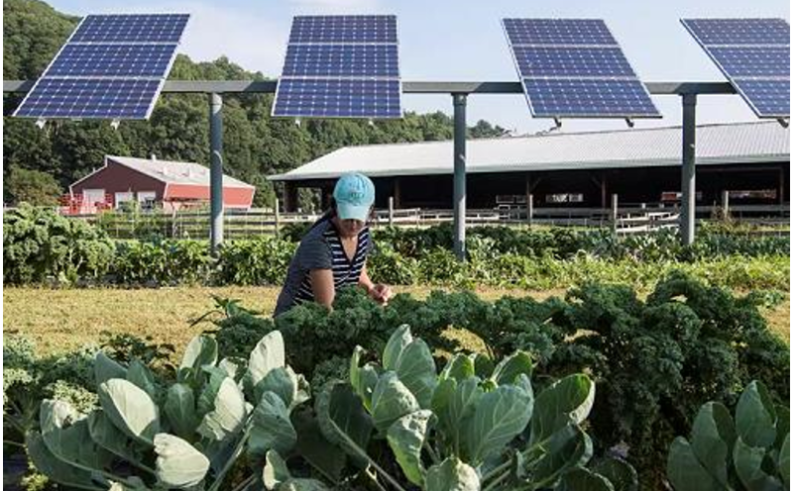
xgap = 2 to 5 ft!
2m
Bed West
A
Bed
Center
B
Bed East
C
Bed West
A

Slide 2
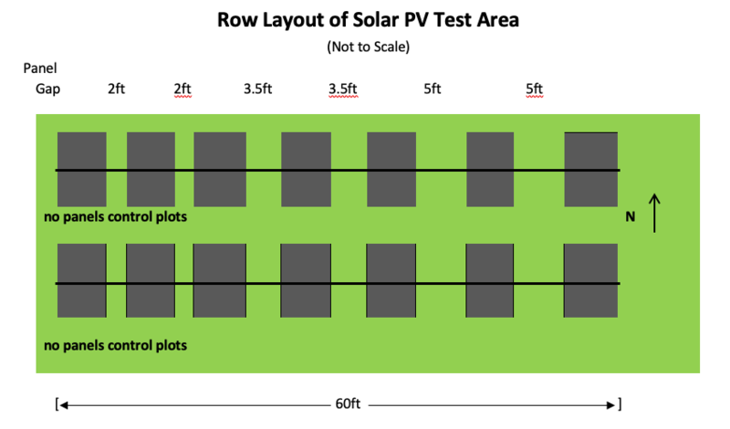
-5 to
Collector
Modules in Landscape
numpanels = 3-up
ygap = 0
Xgap variable
x = 2 m y = 1 m
Scene Object 1
Xcoord = 0, ycoord = 0
nMods = 3
nRows = 2
pitch = 15 m
Xgap = 2ft
Scene Object 2
nMods = 2
nRows = 2
pitch = 15 m
Xgap = 3.5ft
ycord = 0
Xcoord = x*nMods_ob1/2+xgap_obj1
+ xgap_obj2 + x/2
Scene Object 3
nMods = 2
nRows = 2
pitch = 15 m
Xgap = 5ft
ycord = 0
Xcoord = nMods_ob1*x/2+xgap_obj1
+ xgap_obj2 + x*2 + xgap_obj2+xgap_obj3 + x/2

